Slide 1
CS611 · ASSIGNMENT 2 · ML PIPELINE
Loan default prediction: choosing, testing and stress-testing the model
Model selection · imbalance treatment · feature importance and selection · hyperparameter tuning · error and robustness analysis · deployment and operations
Checklist V6.6, steps 24–36 · scikit-learn · XGBoost · SHAP · Optuna · MLflow
October 2026
CS611 Assignment 2 · Loan default ML pipeline · Checklist V6.6 steps 24–36
1
Notes:
This deck continues the data and feature pipeline deck (steps 01-23). It covers how the model was chosen how far we can trust it, and how it runs in production: steps 24-36 of the V6.6 checklist.

Slide 2
The ML pipeline at a glance
STEP 24
STEP 25
STEP 26
STEP 27–28
STEP 29
STEP 30–31
STEP 32
STEP 33–36
Baseline
Candidates
Imbalance
Features
Tuning
Select + test
Robustness
Deploy + operate
metric contract fixed
3 algorithms × 4 sets
weighting tested
SHAP, 1-SE reduction
Optuna, 60 trials
sign-off, test + OOT
errors, stress tests
registry, scoring, monitoring, Airflow
12
0.619
+0.077
70%
8/8
30
candidate models compared on identical folds
champion PR-AUC on later loans (OOT)
over the logistic baseline on OOT
of OOT defaulters caught
stress tests passed
features in the champion
Fair comparison: every model uses the same 5 cross-validation folds, the same metric contract and train-only fitting; test and OOT were used only once, to evaluate the signed-off model.
Primary metric: PR-AUC, because defaulters are the minority (29%); a model must beat the baseline by at least 0.02 (and more than fold noise) to count as better.
CS611 Assignment 2 · Loan default ML pipeline · Checklist V6.6 steps 24–36
2
Notes:
Eight stages, each with a recorded decision. Headline: the champion scores PR-AUC 0.619 on loans from a later period it never saw, 0.077 better than the baseline, and passes all stress tests.

Slide 3
PART 1
Model selection
A fixed baseline and metric, twelve candidates on identical folds, a champion that can be deployed, and one honest test on untouched data.
Steps 24, 25, 30, 31
CS611 Assignment 2 · Loan default ML pipeline · Checklist V6.6 steps 24–36
3

Slide 4
The rules were fixed before any candidate was trained
STEP 24
Item | Decision
Primary metric | PR-AUC (average precision)
Also reported | ROC-AUC, Brier, log loss, precision / recall / F1
Better means | +0.02 CV PR-AUC and more than the baseline's fold std
Protocol | 5-fold stratified CV on train (seed 42), then validation
Threshold | max F1 on validation; never on test / OOT
Cost of errors | none assumed (no business basis)
Target for every candidate
CV PR-AUC ≥ 0.584 (baseline 0.564 ± 0.010 + 0.02). The dummy model's 0.289 is the default rate: the floor.
CS611 Assignment 2 · Loan default ML pipeline · Checklist V6.6 steps 24–36
4
Notes:
Fixing the metric, folds and improvement rule before seeing any candidate prevents choosing the metric that flatters the result. The 5:1 cost assumption was removed because there was no business basis for it.

Slide 5
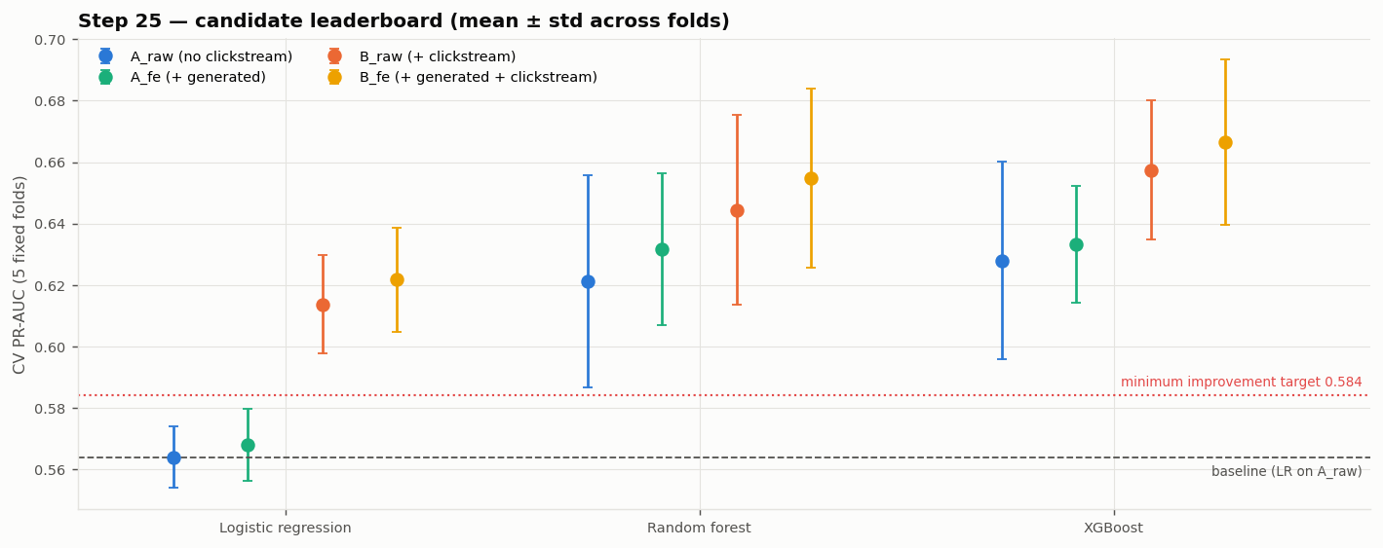
12 candidates: tree models win, clickstream helps
STEP 25
Candidate | CV PR-AUC | Val PR-AUC
XGB__B_fe | 0.667 ± 0.027 | 0.633
XGB__B_raw | 0.657 ± 0.023 | 0.626
RF__B_fe | 0.655 ± 0.029 | 0.629
RF__B_raw | 0.644 ± 0.031 | 0.613
XGB__A_fe | 0.633 ± 0.019 | 0.616
RF__A_fe | 0.632 ± 0.025 | 0.606
LR__A_raw (baseline) | 0.564 | 0.577
Algorithm matters most: on the same features, XGB / RF beat logistic regression by about 0.06 — they capture thresholds and interactions.
Clickstream adds +0.029 for XGB; generated (OpenFE) features add +0.005 — inside fold noise.
CS611 Assignment 2 · Loan default ML pipeline · Checklist V6.6 steps 24–36
5
Notes:
LR, random forest and XGBoost on four feature sets: A without clickstream, B with clickstream, raw or with OpenFE features. Same folds, same preprocessing refit inside every fold. LR on A_raw reproduces the baseline exactly, which proves the comparison is fair.

Slide 6
Where the gains come from
STEP 25
Reading the chart
Each bar is the gain from adding a feature group to the same algorithm. Fold-to-fold spread is about ±0.02, so bars below that are within noise.
Consequence
Clickstream is the most valuable extra source, but it stops in 2024-06. OpenFE features help a little; their value was settled by the feature-reduction rule (step 28).
CS611 Assignment 2 · Loan default ML pipeline · Checklist V6.6 steps 24–36
6
Notes:
Native chart: editable in PowerPoint. LR gains most from clickstream (+0.05) because it cannot build interactions itself.

Slide 7
Why model A is the champion
STEPS 27, 30
 | Model A — champion | Model B — challenger
Algorithm / features | XGBoost · 30 (no clickstream) | XGBoost · 25 (10 clickstream)
CV PR-AUC | 0.640 | 0.666
Validation PR-AUC | 0.601 | 0.647
Test PR-AUC (in-time) | 0.613 | 0.640
Can be tested on OOT | yes | no — no clickstream after 2024-06
Can score new applicants | yes | no — feed stopped
B's edge is not significant
On test, B − A = +0.027, 95% bootstrap CI [-0.007, +0.062] — includes zero.
Without clickstream, B falls behind
Scored on OOT with clickstream missing, B gets 0.610 vs the champion's 0.619. B is ready if the clickstream feed is restored.
CS611 Assignment 2 · Loan default ML pipeline · Checklist V6.6 steps 24–36
7
Notes:
RF was tied with XGB (0.632 vs 0.633) but is 8x slower to score, larger, and has no built-in SHAP; it is recorded as an equivalent alternative. A is the champion because it can be fed and verified on new loans.

Slide 8
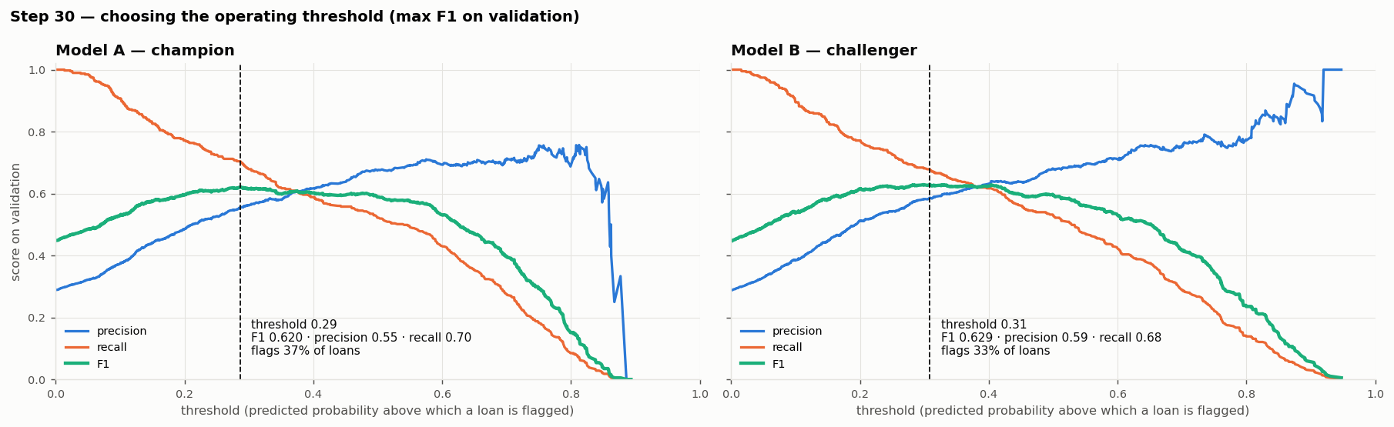
Operating threshold: maximise F1 on validation
STEP 30
Model | Threshold | Precision | Recall | F1 | Loans flagged
LR__A_raw (baseline) | 0.32 | 0.54 | 0.66 | 0.597 | 35%
XGB model A (champion) | 0.29 | 0.55 | 0.70 | 0.620 | 37%
XGB model B (challenger) | 0.31 | 0.59 | 0.68 | 0.629 | 33%
Why max F1
No business cost of a missed default vs a false alarm was available, so precision and recall are weighted equally.
CS611 Assignment 2 · Loan default ML pipeline · Checklist V6.6 steps 24–36
8
Notes:
F1 is flat between thresholds 0.2 and 0.4, so the exact choice is not fragile (step 32 confirms on OOT). Probabilities are well calibrated (mean predicted 0.28 vs actual 0.29), so the model was not reweighted.

Slide 9
One honest test: the champion holds up on later loans
STEP 31
Champion − baseline | Δ PR-AUC | 95% CI
TEST | +0.048 | [+0.008, +0.092]
OOT | +0.077 | [+0.054, +0.105]
At the fixed threshold on OOT
Flags 35% of loans · catches 707 of 1,011 defaulters (70%) · precision 0.58 · F1 0.631.
Used once, after sign-off: the approval was recorded first; nothing re-selected afterwards. No drop from validation (0.601) to OOT (0.619).
CS611 Assignment 2 · Loan default ML pipeline · Checklist V6.6 steps 24–36
9
Notes:
Test = same period, never used. OOT = 3,526 loans that started after every training loan. Both CIs exclude zero, so the improvement over the baseline is real, not noise.

Slide 10
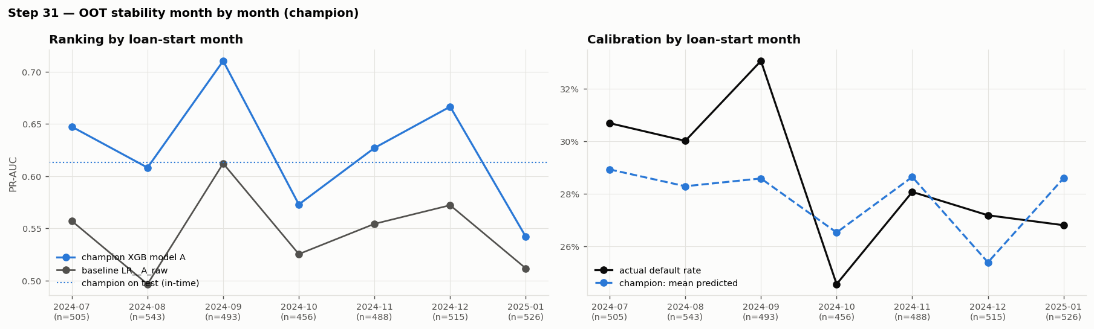
Stable month by month on the out-of-time period
STEP 31
Above the baseline every month; monthly PR-AUC 0.54–0.71. Weakest month 2025-01 — a monitoring item, not a trend.
Calibration holds: predicted and actual default rates move together; score distribution train → OOT PSI 0.025 (stable).
CS611 Assignment 2 · Loan default ML pipeline · Checklist V6.6 steps 24–36
10
Notes:
Month-level PR-AUC moves with sample size (~500 loans per month). The point is that there is no downward trend after the training period.

Slide 11
PART 2
Imbalance treatment
29% of loans default: is the minority class too small for the models to learn? We tested class weighting instead of assuming it helps.
Step 26
CS611 Assignment 2 · Loan default ML pipeline · Checklist V6.6 steps 24–36
11

Slide 12
Options considered and how they were tested
STEP 26
Option | What it does | Decision
No weighting | every loan counts the same | reference
√ratio weight (≈1.57) | defaulters count 1.57× | tested
Balanced weight (≈2.46) | both classes equal total weight | tested
Undersampling | drop ~40% of non-defaulters | not tested — data too small
SMOTE / oversampling | synthetic defaulters | not tested — little benefit at 29%
28.9%
2.46
training default rate (1,813 / 6,281)
non-defaulters per defaulter
Test design
Weights computed inside each training fold, applied as sample_weight. Same 5 folds, same metric. Adopt only if CV PR-AUC improves by ≥ 0.02. Brier score and mean predicted probability reported, because weighting inflates probabilities.
CS611 Assignment 2 · Loan default ML pipeline · Checklist V6.6 steps 24–36
12
Notes:
A 29% minority is mild; weighting usually matters below ~5%. We tested it rather than skipping the step.

Slide 13
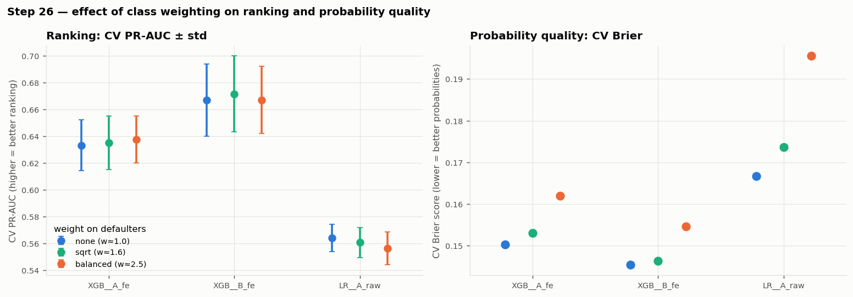
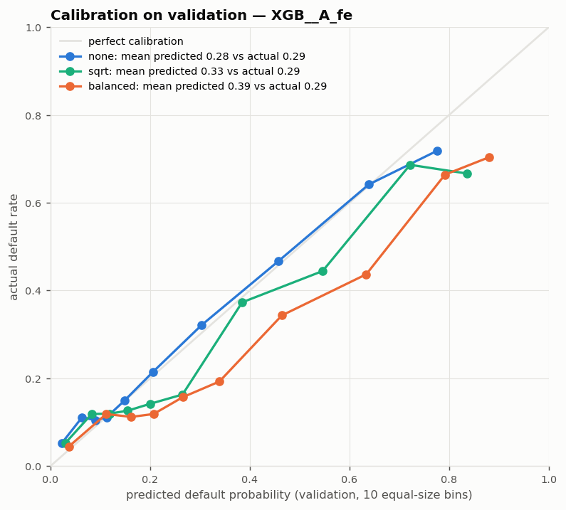
Weighting: no better ranking, worse probabilities
STEP 26
Model | Weight | CV PR-AUC | Δ | CV Brier | Mean predicted
XGB__A_fe | none | 0.633 | +0.000 | 0.150 | 0.28
XGB__A_fe | sqrt | 0.635 | +0.002 | 0.153 | 0.33
XGB__A_fe | balanced | 0.638 | +0.004 | 0.162 | 0.39
XGB__B_fe | none | 0.667 | +0.000 | 0.145 | 0.28
XGB__B_fe | sqrt | 0.671 | +0.005 | 0.146 | 0.33
XGB__B_fe | balanced | 0.667 | +0.000 | 0.155 | 0.37
LR__A_raw | none | 0.564 | +0.000 | 0.167 | 0.29
LR__A_raw | sqrt | 0.561 | -0.003 | 0.174 | 0.36
LR__A_raw | balanced | 0.556 | -0.008 | 0.196 | 0.45
Decision: no weighting
Largest gain +0.005 (rule needs +0.02); Brier worse; the max-F1 threshold already balances precision and recall.
CS611 Assignment 2 · Loan default ML pipeline · Checklist V6.6 steps 24–36
13
Notes:
Actual default rate is 0.29. Balanced weighting pushes the average predicted probability to 0.39 for XGB and 0.45 for LR, so the probabilities would no longer mean 'chance of default'.

Slide 14
PART 3
Feature importance and selection
What does the model rely on, does it make sense, and how few features can it use without losing accuracy?
Steps 27, 28
CS611 Assignment 2 · Loan default ML pipeline · Checklist V6.6 steps 24–36
14

Slide 15
What the champion relies on (SHAP, final model)
STEPS 27, 30
Debt × stress signals dominate
Most top features combine outstanding debt with interest rate, inquiries, delays or credit-history length; payment behaviour is the strongest single original field.
Checks passed
Largest single feature ≈ 10% of importance (no leakage flag). Permutation and SHAP rankings agree (rank correlation 0.73). SHAP values add up exactly to each prediction.
CS611 Assignment 2 · Loan default ML pipeline · Checklist V6.6 steps 24–36
15
Notes:
SHAP (XGBoost built-in TreeSHAP) explains how much each feature pushes each prediction; summed back from one-hot columns to the original features. Permutation importance measures how much CV PR-AUC drops when a feature is shuffled. Names: × multiply, ÷ divide, − subtract (OpenFE combinations).

Slide 16
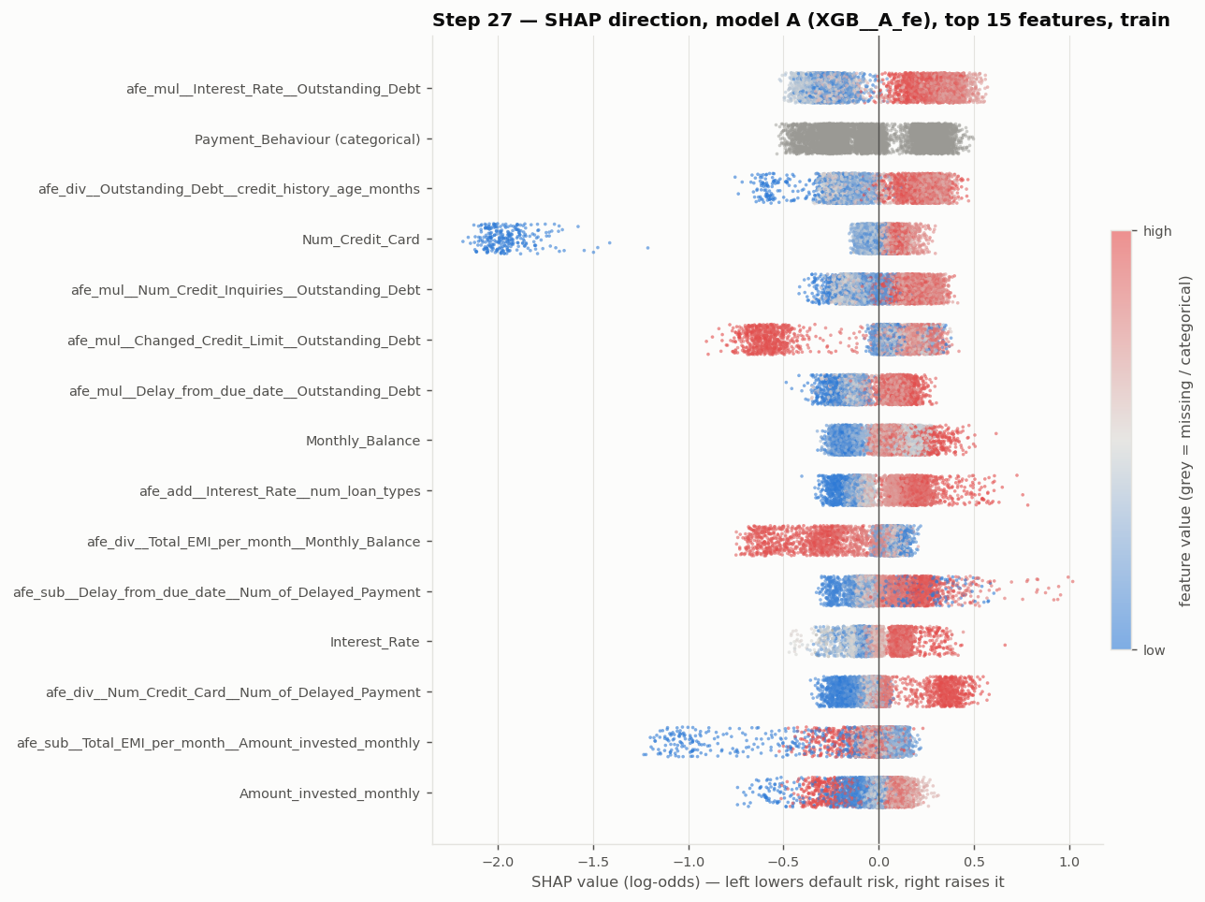
Which way each feature pushes the risk
STEP 27
How to read: one dot per training loan; colour = feature value (red high, blue low); right of zero = raises risk.
High debt × interest rate (red, right) raises risk; low values lower it.
1–2 credit cards (blue dots far left) push risk down strongly — about −2 log-odds: a watch item.
6 direction flips vs simple EDA (e.g. Monthly_Balance) are conditional effects: the model sees each feature together with income and debt.
CS611 Assignment 2 · Loan default ML pipeline · Checklist V6.6 steps 24–36
16
Notes:
Beeswarm of the step-27 SHAP values for model A (66-feature version; the final 30-feature model has the same leading drivers, see the SHAP importance slide).

Slide 17
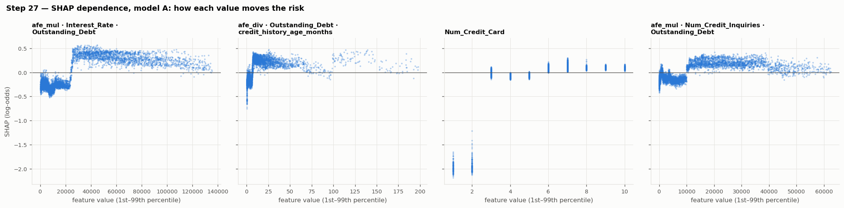
Shape of the effects: thresholds, not straight lines
STEP 27
Sharp steps: e.g. debt × interest rate below ≈ 25,000 lowers risk, above it raises risk; debt ÷ credit-history months jumps at ≈ 8.
Why trees win: step-shaped effects are captured exactly by tree splits but not by one linear coefficient — the ~0.06 PR-AUC gap over logistic regression.
Data note: such clean thresholds suggest the dataset was generated with rules.
CS611 Assignment 2 · Loan default ML pipeline · Checklist V6.6 steps 24–36
17
Notes:
The step-shaped dependence suggests the data was generated with thresholds, which explains why tree models win by ~0.06 PR-AUC.

Slide 18
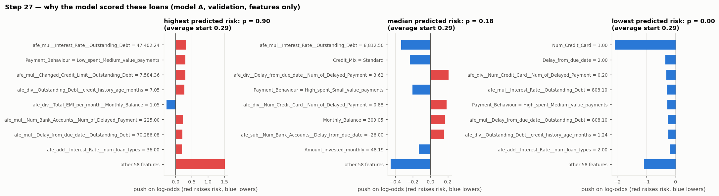
Explaining single decisions
STEP 27
Every score can be explained: starting from the average risk (0.29), each bar shows how one feature moved this loan's score up (red) or down (blue).
Use: reason codes for credit officers and customers; the same computation runs at inference.
CS611 Assignment 2 · Loan default ML pipeline · Checklist V6.6 steps 24–36
18
Notes:
Three validation loans chosen by predicted risk only (labels not used): highest, median and lowest.

Slide 19
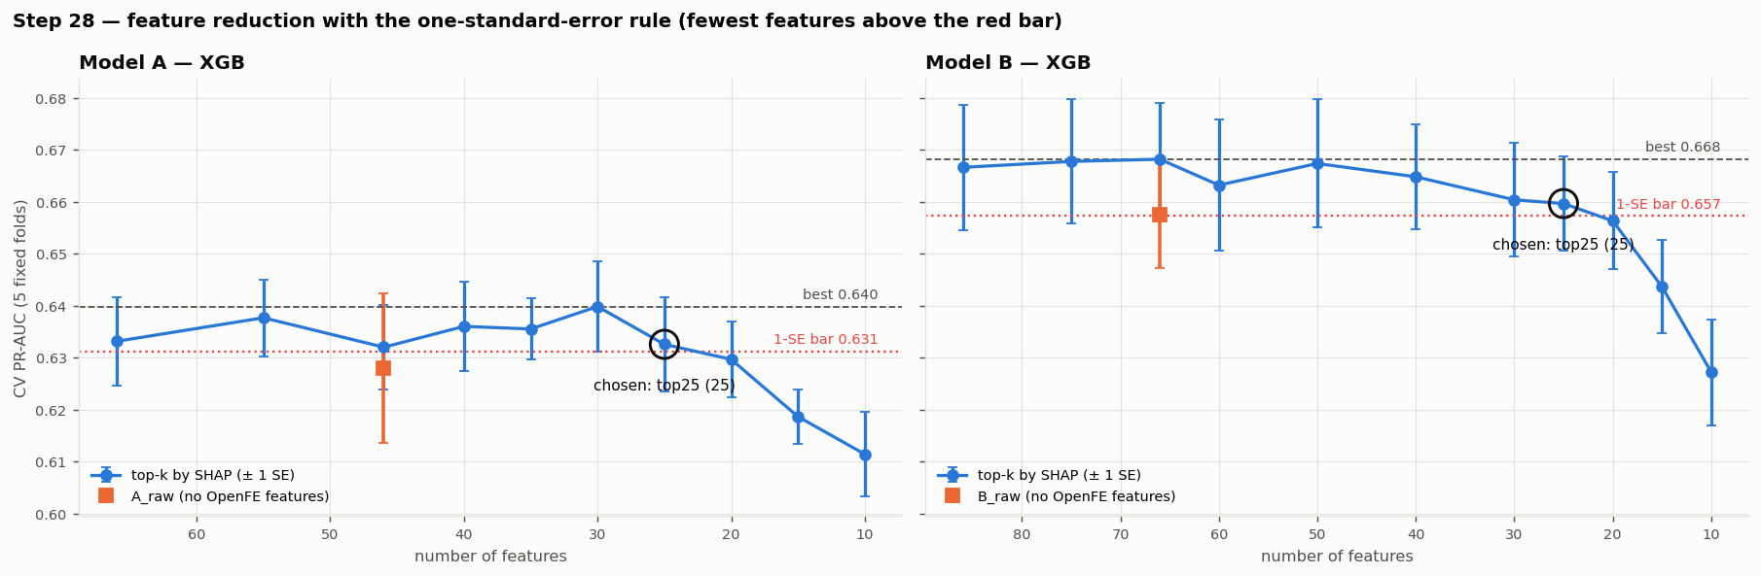
Feature reduction with the one-standard-error rule
STEP 28
 | Model A | Model B
Best set (CV) | top30 0.640 | top66 0.668
1-SE bar | 0.631 | 0.657
Rule picks | top25 | top25
Final | top30 (user) | top25
Rule: among sets whose CV PR-AUC is within one standard error of the best, keep the one with the fewest features (Hastie, Tibshirani & Friedman).
No selection leakage: within each fold, features were ranked by a model trained on that fold's training part only.
Generated features earn their place: A without OpenFE features (0.628) falls below the bar.
Override, recorded: A's rule pick (25) lost 0.026 on validation; the user chose the CV-best 30 instead. Test / OOT then confirmed it independently.
CS611 Assignment 2 · Loan default ML pipeline · Checklist V6.6 steps 24–36
19
Notes:
Fewer features = fewer data feeds that can break, simpler explanations, often better stability. The override is documented as chosen after seeing validation, so validation is not untouched for model A.

Slide 20
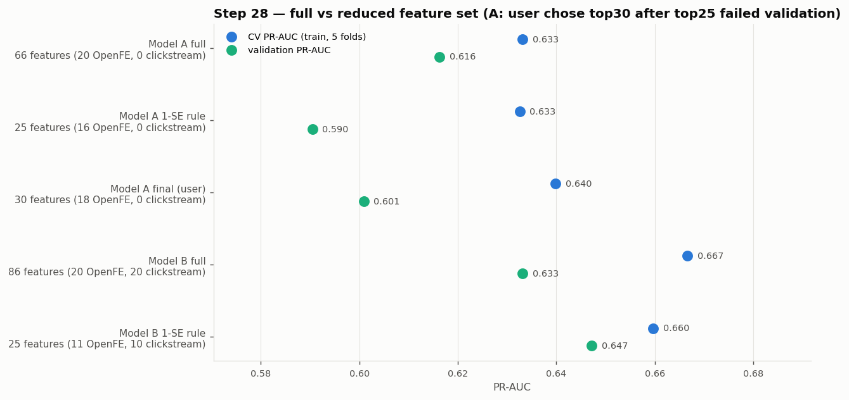
Full vs reduced feature sets
STEP 28
Model | Version | Features | OpenFE | Click | CV | Val
A | full | 66 | 20 | 0 | 0.633 | 0.616
A | 1-SE rule | 25 | 16 | 0 | 0.633 | 0.590
A | final (user) | 30 | 18 | 0 | 0.640 | 0.601
B | full | 86 | 20 | 20 | 0.667 | 0.633
B | 1-SE rule | 25 | 11 | 10 | 0.660 | 0.647
Champion: 66 → 30 features (18 OpenFE combinations + 12 original fields); B: 86 → 25.
Dropped include all _invalid flags, loan-type flags, Age, Occupation, Annual_Income — their information overlaps with kept features.
CS611 Assignment 2 · Loan default ML pipeline · Checklist V6.6 steps 24–36
20
Notes:
Age is not used by the champion, which is also helpful for fairness.

Slide 21
PART 4
Hyperparameter tuning
Optuna searched XGBoost settings on the chosen features. Tuning had to beat the defaults by the same rule as any other change.
Step 29
CS611 Assignment 2 · Loan default ML pipeline · Checklist V6.6 steps 24–36
21

Slide 22
Search design
STEP 29
Setting | Search range
Number of trees | 100 – 1,000
Learning rate | 0.01 – 0.3 (log scale)
Tree depth | 2 – 8
Min child weight | 1 – 20 (log)
Row / column sample | 0.5 – 1.0 / 0.4 – 1.0
L2 / L1 regularisation | 0.001 – 10 / 1e-8 – 10 (log)
Min split gain | 0 – 5
How
Optuna TPE sampler, seed 42, 60 trials per model. Trial 0 = current defaults. Each trial scored by mean PR-AUC on the same 5 fixed folds (preprocessing inside each fold).
Adoption rule
Tuned settings replace the defaults only if CV PR-AUC improves by ≥ 0.02 and by more than the default's fold std. The best of 60 trials is optimistic (chosen and scored on the same folds), so validation is checked too.
CS611 Assignment 2 · Loan default ML pipeline · Checklist V6.6 steps 24–36
22
Notes:
Features fixed from step 28 (A: 30, B: 25). No class weighting (step 26).

Slide 23
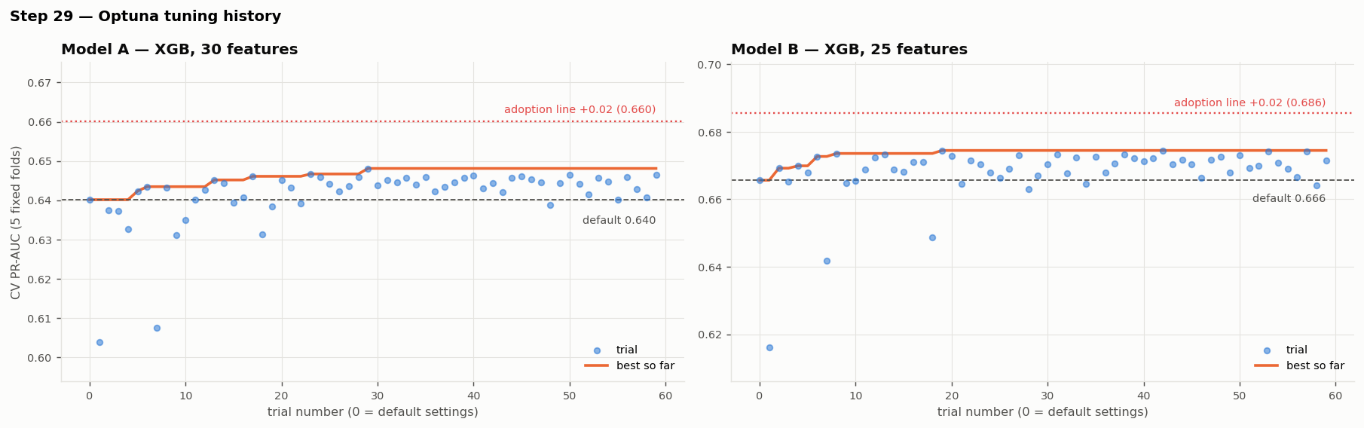
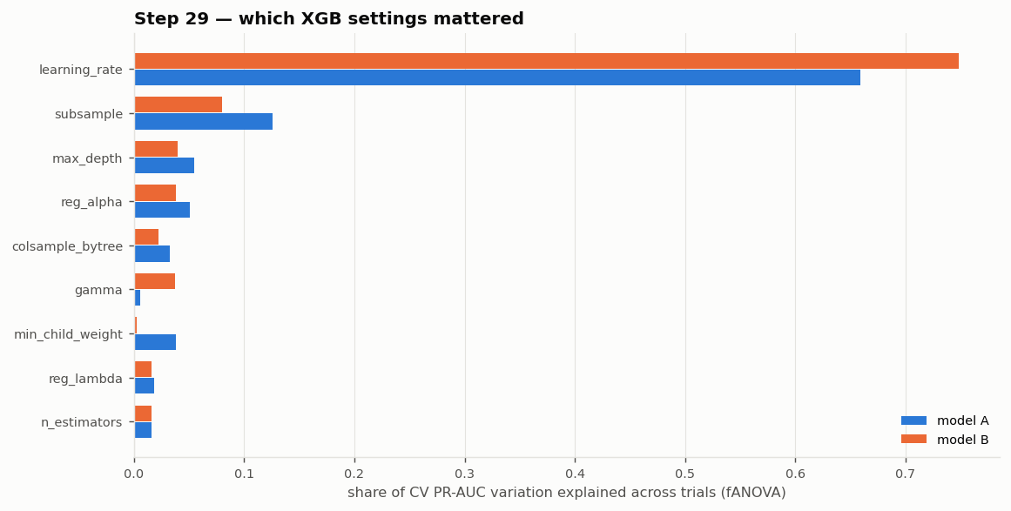
Tuning gains stay within noise: defaults kept
STEP 29
Result
Model | Version | CV PR-AUC | Gain | Val PR-AUC | Adopted
A | default | 0.640 | +0.000 | 0.601 | yes
A | tuned (best trial) | 0.648 | +0.008 | 0.595 | no
B | default | 0.666 | +0.000 | 0.647 | yes
B | tuned (best trial) | 0.674 | +0.009 | 0.655 | no
Best trials: A +0.008, B +0.009 (rule needs +0.02). On validation A's tuned model is worse. Learning rate explains most of the variation; the defaults were already near the optimum.
CS611 Assignment 2 · Loan default ML pipeline · Checklist V6.6 steps 24–36
23
Notes:
Keeping defaults is a valid outcome: it avoids overfitting the folds through 60 attempts.

Slide 24
PART 5
Error and robustness analysis
Where does the champion make mistakes, for whom, and how much bad input can it take before it breaks?
Step 32
CS611 Assignment 2 · Loan default ML pipeline · Checklist V6.6 steps 24–36
24

Slide 25
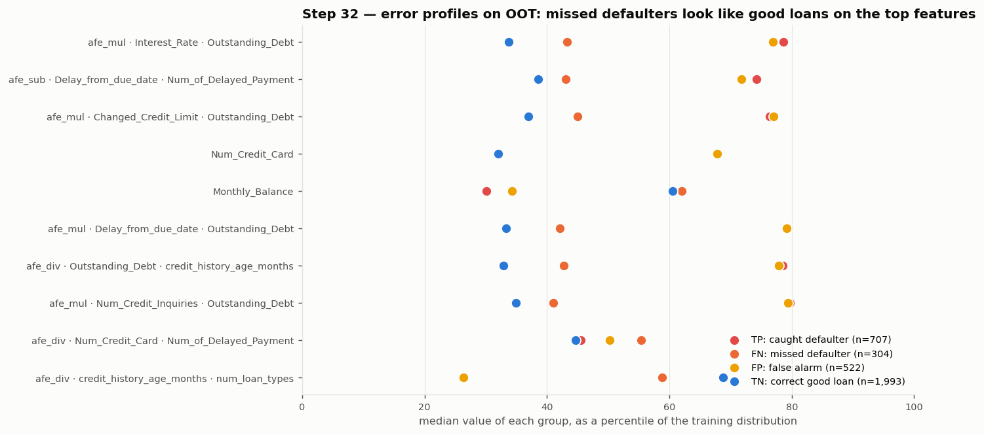
Where the errors are
STEP 32
Missed defaulters look like good loans: on the debt features they sit near the 40th–45th percentile, while caught defaulters sit near the 78th — hard cases, not a bug.
False alarms look like defaulters on the same features — the price of catching 70% of defaults.
CS611 Assignment 2 · Loan default ML pipeline · Checklist V6.6 steps 24–36
25
Notes:
Error profile chart: median value of each outcome group on the top features, as a percentile of training data.

Slide 26
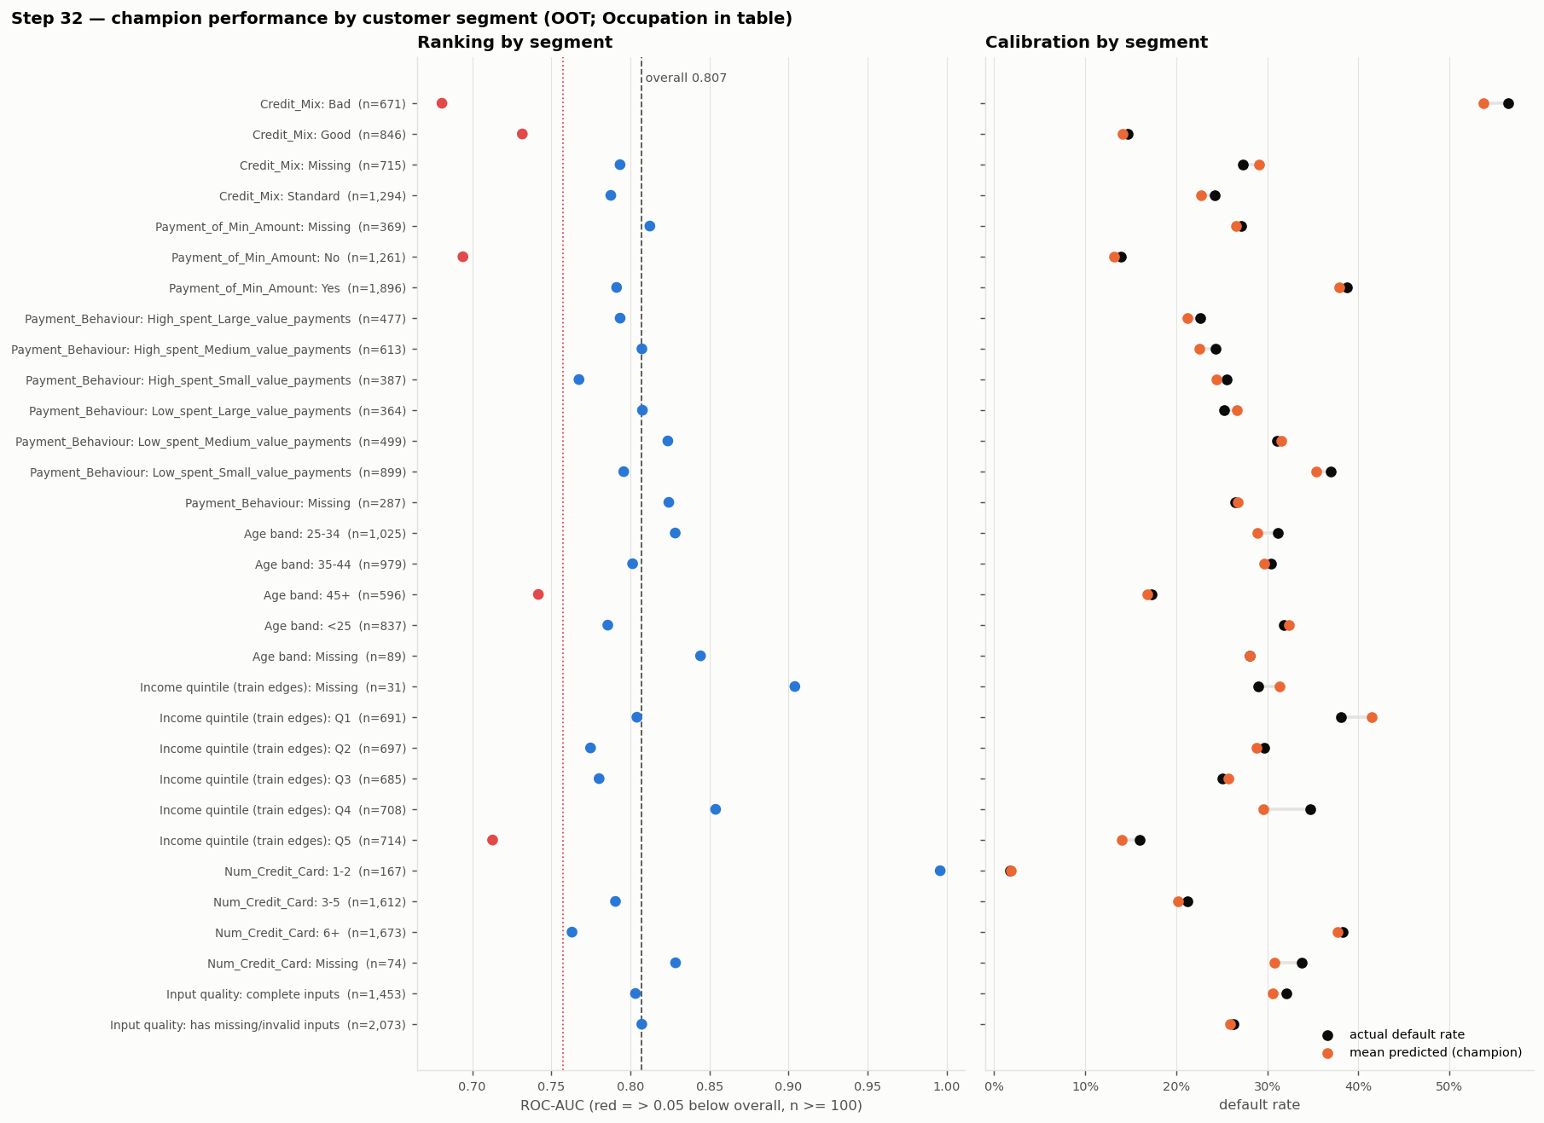
Segments: few real weaknesses
STEP 32
Set | Segment | n | Actual | Predicted
OOT | Occupation: Manager | 218 | 30% | 24%
OOT | Income quintile (train edges): Q4 | 708 | 35% | 30%
TEST | Credit_Mix: Bad | 254 | 60% | 55%
TEST | Payment_Behaviour: Missing | 113 | 34% | 26%
Most ranking flags are expected: inside a group where the main risk signal is constant (e.g. Credit_Mix = Bad), ranking is naturally harder.
Under-prediction of ~5–8 points for the segments in the table — monitor after deployment.
Age 45+ ranks lower (ROC 0.74 vs 0.81); age is not a model feature — a fairness note.
CS611 Assignment 2 · Loan default ML pipeline · Checklist V6.6 steps 24–36
26
Notes:
Segments flagged when n >= 100 and ROC-AUC is more than 0.05 below overall, or calibration gap > 5 points.

Slide 27
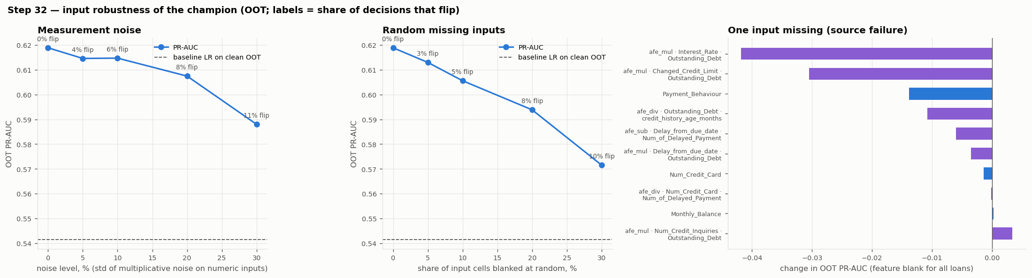
Robust to noisy and missing inputs
STEP 32
Stress test | Result
all inputs missing -> valid probability | PASS
unseen category values -> valid probability | PASS
extreme numeric values -> valid probability | PASS
column order shuffled -> identical predictions | PASS
Stress test | Result
extra unused columns -> identical predictions | PASS
deterministic (same input twice) | PASS
single-row = batch predictions | PASS
required column absent -> clear error (not silent) | PASS
CS611 Assignment 2 · Loan default ML pipeline · Checklist V6.6 steps 24–36
27
Notes:
10% noise costs 0.004 PR-AUC; 10% random missing costs 0.013; even 30% missing (0.572) stays above the clean baseline (0.542). The critical single input is Interest_Rate x Outstanding_Debt (-0.042 if lost), so the interest-rate and outstanding-debt fields are the first to monitor.

Slide 28
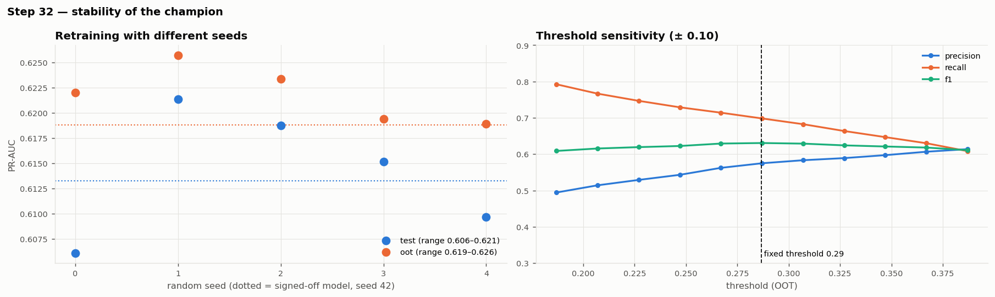
Stable across seeds and thresholds
STEP 32
0.619–0.626
96%
0.61–0.63
0.610
OOT PR-AUC across 5 retraining seeds
of decisions unchanged by the seed (worst case)
F1 range for threshold ± 0.10
challenger B on OOT without clickstream (< champion)
CS611 Assignment 2 · Loan default ML pipeline · Checklist V6.6 steps 24–36
28
Notes:
Retraining with different random seeds barely changes the model; the threshold is not on a knife edge.

Slide 29
PART 6
Deployment & operations
Register the approved model, score new loans every month, watch it, decide when to refresh — orchestrated by three Airflow DAGs in Docker.
Steps 33–36 + Airflow
CS611 Assignment 2 · Loan default ML pipeline · Checklist V6.6 steps 24–36
29

Slide 30
Registered for deployment (MLflow)
STEP 33
Alias | Version | Model | Features | Threshold
@champion | 1 | XGB model A | 30 | 0.287
@challenger | 2 | XGB model B | 25 | 0.308
@baseline | 3 | logistic regression | 43 | 0.324
Reproducible
Reloading models:/loan_default_30dpd_6mob@champion reproduces the step-31 predictions exactly; re-running does not create duplicate versions.
Inputs: the approved step-30 sign-off and the step-31 evaluation.
Each version carries the full pipeline with input signature, metrics, threshold, lineage tags and governance files.
Inference loads @champion; promotion or rollback = moving an alias, no code change.
Local, no server
SQLite registry under datamart/ml/mlflow/ — the same on Windows and in Docker. Browse with `mlflow ui`.
CS611 Assignment 2 · Loan default ML pipeline · Checklist V6.6 steps 24–36
30
Notes:
Registry is a local SQLite store. Aliases decouple the deployed model from the code: inference always asks for @champion.

Slide 31
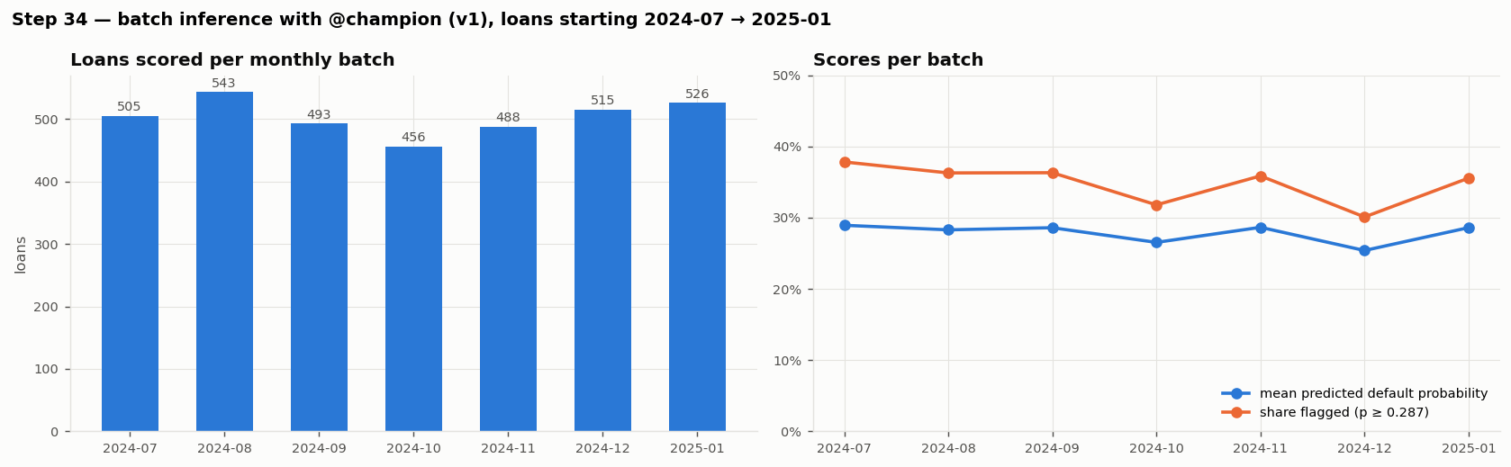
Monthly batch scoring with @champion
STEP 34
Check | Result
every OOT loan scored exactly once | PASS
predictions equal the step-31 champion predictions | PASS
probabilities valid, no missing values | PASS
threshold and version from the registry alias | PASS
flag rate matches step 31 at the same threshold | PASS
3,526
34.9%
loans scored
flagged high-risk
Deployed path = evaluated model
Same predictions as step 31 (difference 0).
CS611 Assignment 2 · Loan default ML pipeline · Checklist V6.6 steps 24–36
31
Notes:
Each month: Gold features of the loans starting that month, OpenFE formulas recomputed row by row (nothing fitted, no labels), model loaded by alias, threshold from the registry tag, three SHAP reason codes per loan.

Slide 32
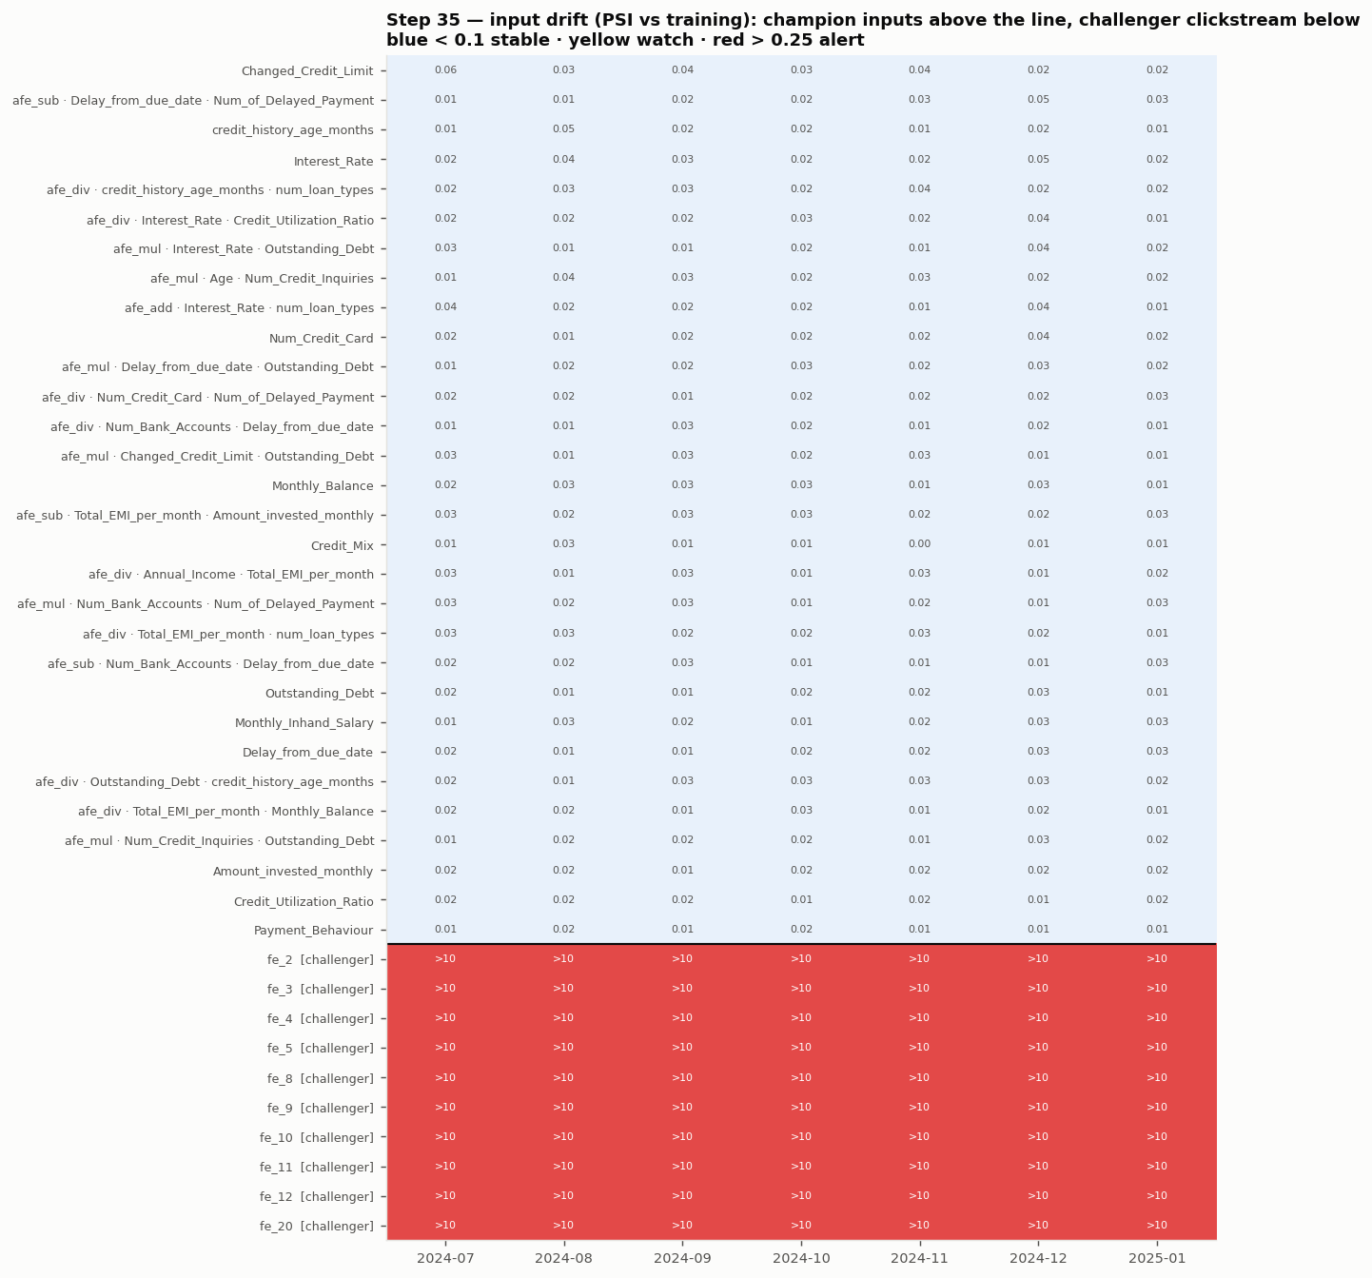
Monitoring: what is checked, and when
STEP 35
Layer | Available | Rule
Data quality | at scoring | missing values +10 pp vs training → alert
Input drift (PSI) | at scoring | 0.10 watch · 0.25 alert
Score drift, decisions | at scoring | score PSI rules; flagged share ± 10 pp
Performance | 6 months later | PR-AUC − 0.05 alert; calibration ± 5 pp
Replayed on 2024-07 → 2025-07 (no live data yet): the months after training, scored in step 34; labels are used only from the date they would arrive.
Champion inputs stable: every input PSI ≤ 0.06 in every month (heatmap, blue).
Challenger: clickstream inputs red from the first month — the feed is empty.
CS611 Assignment 2 · Loan default ML pipeline · Checklist V6.6 steps 24–36
32
Notes:
PSI = population stability index: how far a month's distribution of a feature has moved from training. Reference bins and validation metrics are frozen at training time (monitoring_reference.json).

Slide 33
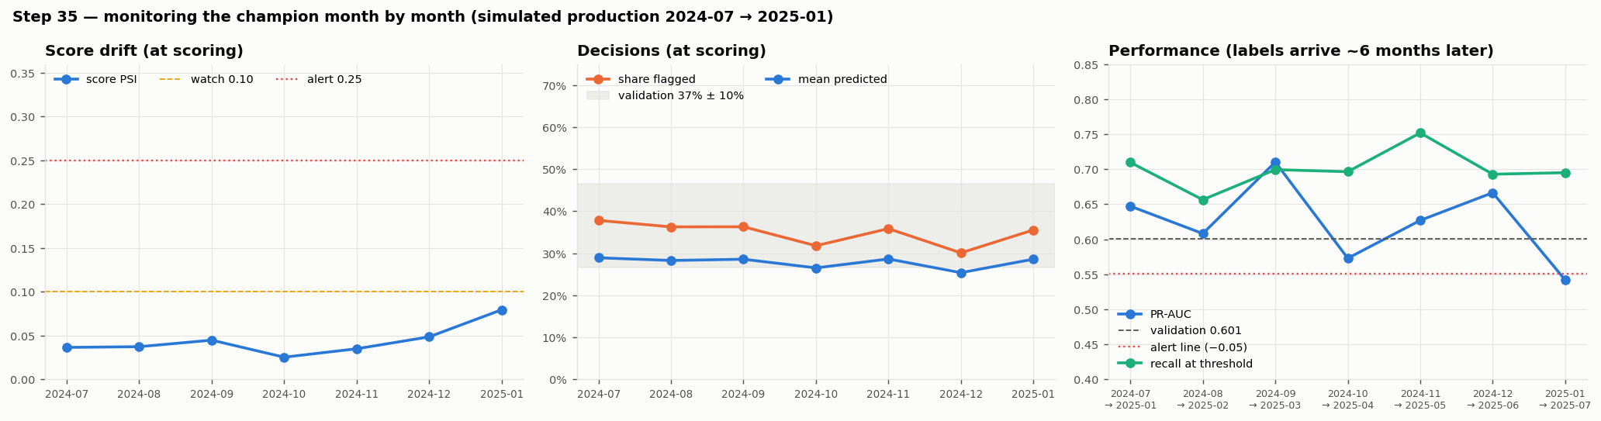
Monitoring results: one late performance alert
STEP 35
Loan month | Loans | Score PSI | Flagged | Labels on | PR-AUC | Recall | Calib. gap
2024-07 | 505 | 0.037 | 38% | 2025-01 | 0.647 | 0.71 | -1.8 pp
2024-08 | 543 | 0.037 | 36% | 2025-02 | 0.608 | 0.66 | -1.7 pp
2024-09 | 493 | 0.045 | 36% | 2025-03 | 0.710 | 0.70 | -4.5 pp
2024-10 | 456 | 0.025 | 32% | 2025-04 | 0.573 | 0.70 | +2.0 pp
2024-11 | 488 | 0.035 | 36% | 2025-05 | 0.627 | 0.75 | +0.6 pp
2024-12 | 515 | 0.049 | 30% | 2025-06 | 0.666 | 0.69 | -1.8 pp
2025-01 | 526 | 0.079 | 36% | 2025-07 | 0.542 | 0.70 | +1.8 pp
The only champion alert
Loans from 2025-01: PR-AUC 0.542, below the 0.551 alert line — known on 2025-07-01. Inputs and scores were stable, so: investigate, no early refit.
CS611 Assignment 2 · Loan default ML pipeline · Checklist V6.6 steps 24–36
33
Notes:
Left: score drift known at scoring. Middle: share flagged stays inside the validation band. Right: performance appears 6 months later, when the month-6 labels arrive.

Slide 34
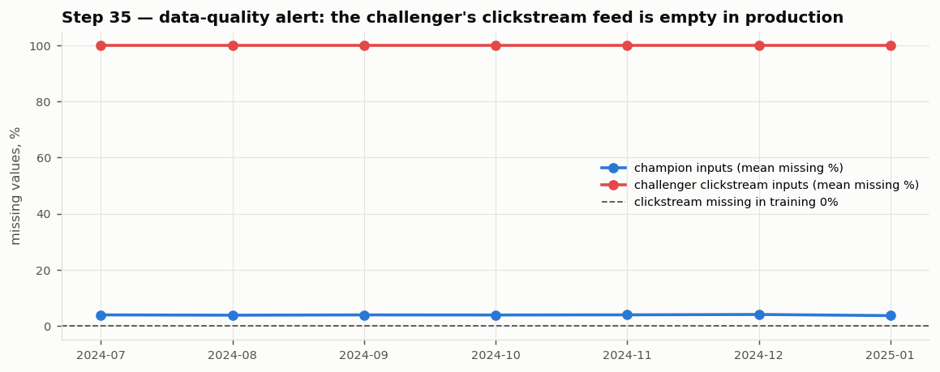
Monitoring catches a broken data feed automatically
STEP 35
Model | Check | Severity | Items | First raised
challenger | input drift (PSI) | ALERT | 10 | 2024-07-31
challenger | missing values | ALERT | 10 | 2024-07-31
champion | PR-AUC | ALERT | 1 | 2025-07-01
Challenger B: its 10 clickstream inputs are 100% missing in every production month — PSI > 10 and a missing-value alert on the very first batch (2024-07-31).
Same problem found by hand in the EDA (clickstream ends 2024-06) — monitoring would have raised it without anyone looking.
Champion: no input or score alerts in any month.
CS611 Assignment 2 · Loan default ML pipeline · Checklist V6.6 steps 24–36
34
Notes:
Good illustration of why monitoring includes data quality, not only model performance.

Slide 35
When to refresh: rules decided in advance
STEP 36
Model | Trigger | Status | Action
champion | input drift | not triggered | none
champion | score drift | not triggered | none
champion | performance | WATCH (single month) | investigate, no model change
champion | calibration | not triggered | none
challenger | data source | TRIGGERED | rebuild
Refresh SOP
• Scheduled refit every 6 months (labels mature after 6), rolling 18-month window
• Early refit only if a trigger persists 2 consecutive months (PSI > 0.25, PR-AUC − 0.05, calibration ± 5 pp)
• Rebuild (steps 21–30) on a source, product or policy change
• Promotion: tests pass, PR-AUC not worse than champion by > 0.01, calibration ok, no new segment weakness, 1 month shadow scoring, approver signs
• Roles: owner, independent validator, approver (risk committee), platform
Champion: only a single-month performance alert → no early refit; investigate the 2025-01 cohort; scheduled refit next.
Challenger: data-source trigger → stays challenger until the clickstream feed returns.
CS611 Assignment 2 · Loan default ML pipeline · Checklist V6.6 steps 24–36
35
Notes:
Two consecutive months because a single month has ~500 loans and its PR-AUC moves several points from sampling alone. Full SOP: output_data/Model_Governance_and_Refresh_SOP.md.

Slide 36
Rollback drill and deployment options
STEP 36
Drill stage | @champion version | Scores changed | Note
after simulated promotion | 3 | yes | inference follows the alias, no code change
after rollback | 1 | no | identical to before the drill
Option | Fits when | Decision
Batch scoring (current) | decision can wait a day; features from snapshots | Recommended — move monthly → daily
Real-time API (mlflow serve / FastAPI) | instant decision at application | Later: needs online features + uptime
Streaming | continuous events, decision per event | Not needed: one decision per loan
Embedded / in-database | scoring must live in another system | Not needed: extra conversion per version
Rollback = move the alias back. Rehearsed on the real registry: @champion moved v1 → v3, scoring switched immediately; moved back, the original predictions were restored exactly. Every move is logged in governance_log.csv.
CS611 Assignment 2 · Loan default ML pipeline · Checklist V6.6 steps 24–36
36
Notes:
Because inference resolves the alias at run time, promotion and rollback need no new image and no code change.

Slide 37
Orchestration: three Airflow DAGs
data_pipeline
Bronze
Silver
Gold feature store
Gold label store
data_ready
monthly · back-fill 2023-01 → 2025-11
model_training
wait for data
full data validation
split
Gold EDA
feature engineering
model development
register
monitoring reference
Jan / Jul (first 2025-07) or triggered
inference
wait for data + @champion
score new loans
monitor
governance check
trigger training if rules fire
monthly · back-fill 2024-07 → 2025-07
Linked by sensors: training and inference wait for the month's data_ready; inference waits for @champion. Each task = python util/pipeline_monthly.py <task> --snapshotdate {{ ds }}.
CS611 Assignment 2 · Loan default ML pipeline · Checklist V6.6 steps 24–36
37
Notes:
On a fresh setup, unpause all three DAGs: data back-fills month by month, training runs at 2025-07 once its data exists and registers @champion, then inference scores and monitors each month in order.

Slide 38
Month by month = full build, and it runs in Docker
Monthly path vs full build | Rows | Result
Bronze (4 tables, one CSV per month) | 377,876 | identical
Silver (4 tables) | 377,876 | identical
Gold feature store | 12,500 | identical
Gold label store | 12,500 | identical
Predictions, 7 months (vs step 34) | 3,526 | identical
Drift, performance, alerts (vs step 35) | 13 months | identical
Docker setup
• Jupyter image + Airflow 2.10 image (webserver, scheduler)
• Pipeline in its own Python environment inside the Airflow image — Airflow's libraries never clash with ours
• Fixes found by clean runs from raw data: Spark memory 4 GB, 4 cores, OpenMP library, kernel registration
Verified in notebooks/pipeline_monthly.ipynb (140 monthly tasks, isolated copy).
Training starts with a full-history validation (cross-table and ledger rules, audit, Gold acceptance) — the checks a single month cannot do.
Cross-platform note
Linux vs Windows: data identical; XGBoost scores differ ≤ 0.005; same decisions.
CS611 Assignment 2 · Loan default ML pipeline · Checklist V6.6 steps 24–36
38
Notes:
This is the evidence that splitting the pipeline into monthly Airflow tasks did not change any result.

Slide 39
Key takeaways
Selected fairly
Proven on unseen data
Every step tested, not assumed
Fixed metric and folds; 12 candidates; champion chosen for deployability, not only score.
OOT PR-AUC 0.619 vs baseline 0.542; no drop from validation; CI excludes zero.
Weighting and tuning tested and rejected by rule; feature set cut 66 → 30.
Understood and robust
Operated, not just trained
Reproducible end to end
SHAP explains each score; noise, missing data, seeds and threshold changes barely move it.
Monthly scoring from the registry; monitoring with delayed labels; rules for refresh and rollback.
Three Airflow DAGs in Docker; month by month identical to the full build.
WATCH ITEMS
2025-01 cohort performance · segment under-prediction (managers, income Q4) · interest-rate and outstanding-debt inputs · challenger blocked until the clickstream feed returns
CS611 Assignment 2 · Loan default ML pipeline · Checklist V6.6 steps 24–36
39
Notes:
Close with the six takeaways and the watch items carried into monitoring.

